Slide 1

AZURE KINECT DK
PROJECT AZURE KINECT DK USING OPEN3D FOR VISUALIZE
YOO SUNG MIN

Slide 2

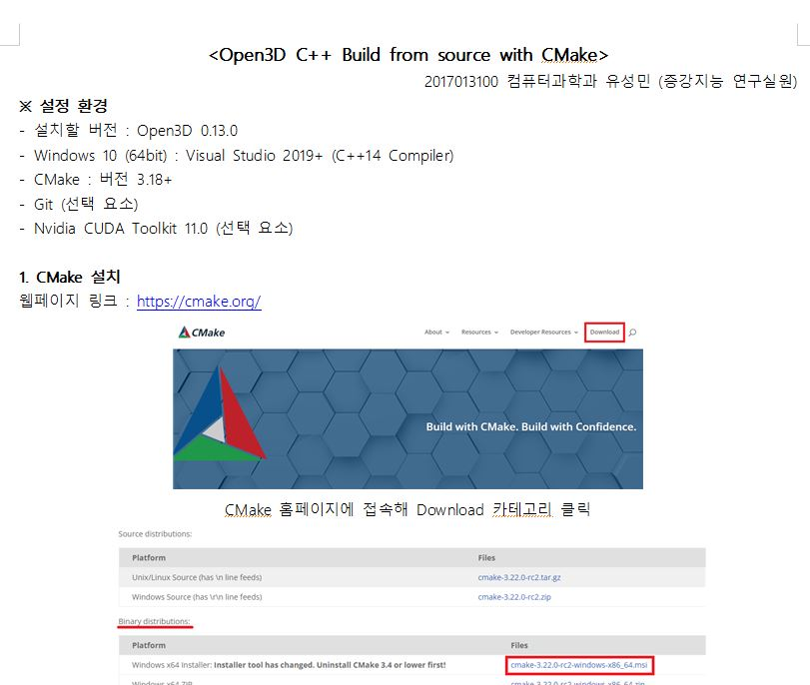
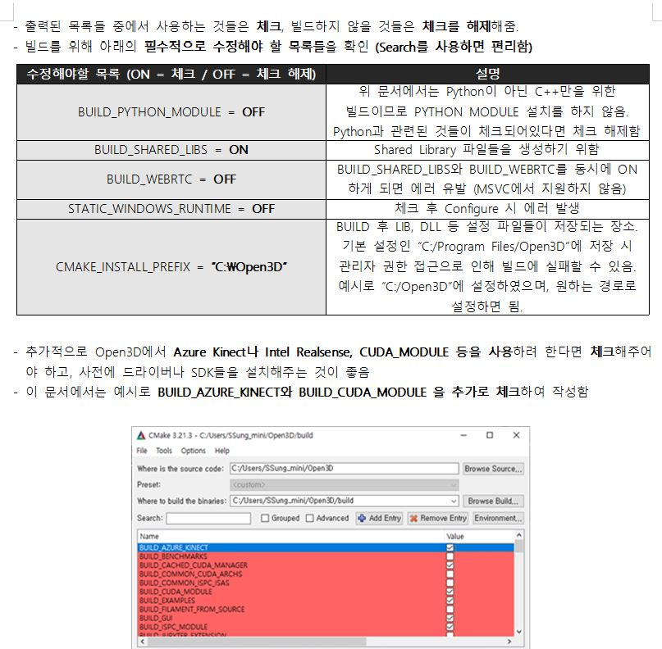
OPEN3D BUILD DOCS.
PROJECT AZURE KINECT DK USING OPEN3D FOR VISUALIZE

Slide 3
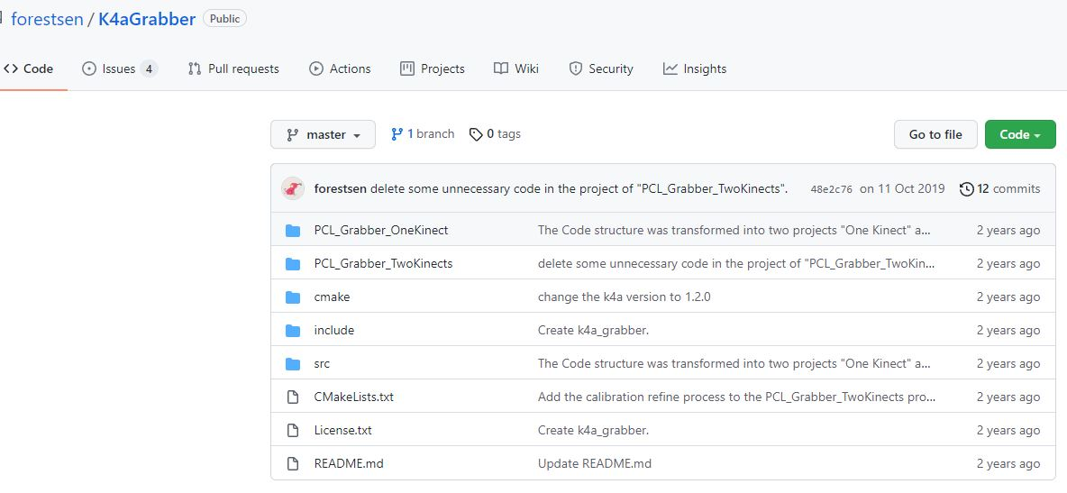
K4A GRABBER
PROJECT AZURE KINECT DK USING OPEN3D FOR VISUALIZE

Slide 4
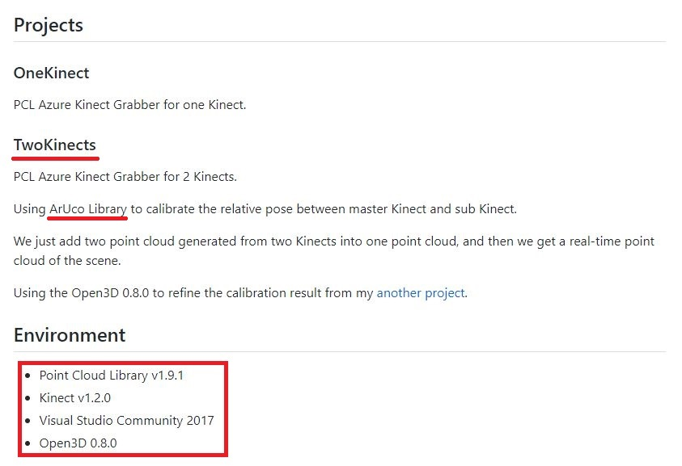

K4A GRABBER
PROJECT AZURE KINECT DK USING OPEN3D FOR VISUALIZE
CMakeList 수정 K4A v1.4.1 Open3D 0.13.0 사용

Slide 5
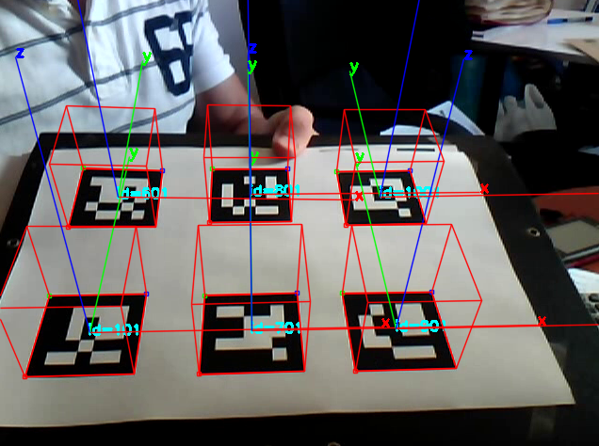


K4A GRABBER
PROJECT AZURE KINECT DK USING OPEN3D FOR VISUALIZE
ArUco OpenCV Extra Module

Slide 6
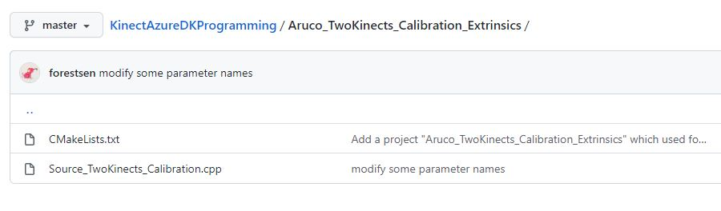
K4A GRABBER
PROJECT AZURE KINECT DK USING OPEN3D FOR VISUALIZE
두 센서의 CameraParameter를 추출한 csv 파일을 Write

Slide 7
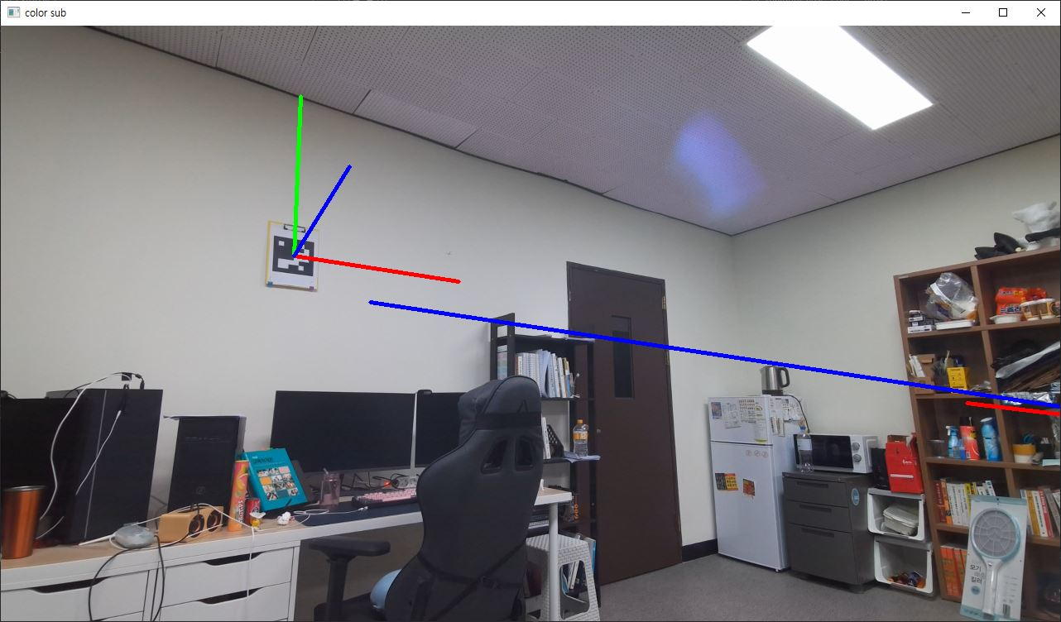
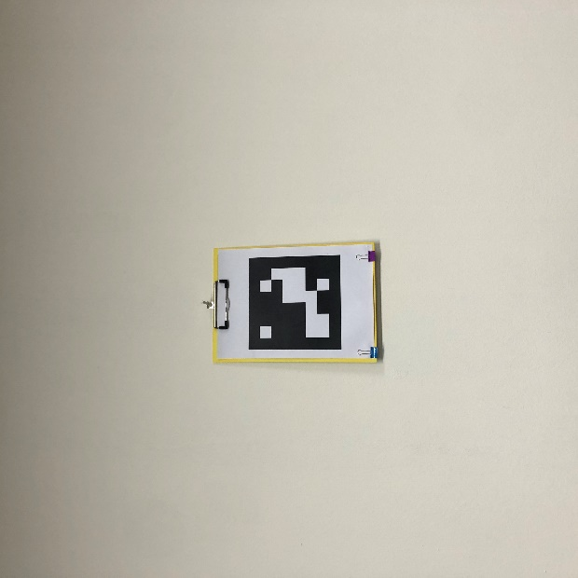

K4A GRABBER
PROJECT AZURE KINECT DK USING OPEN3D FOR VISUALIZE

Slide 8
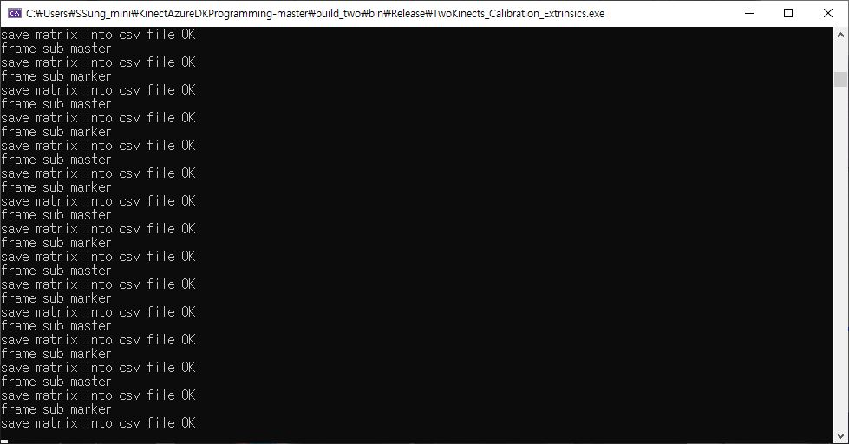
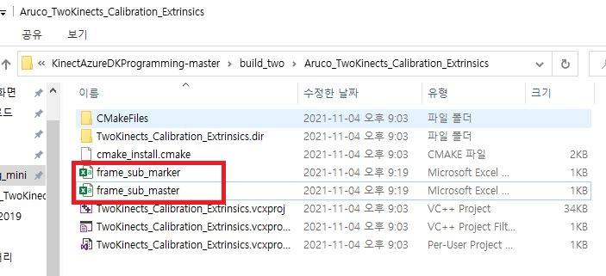
K4A GRABBER
PROJECT AZURE KINECT DK USING OPEN3D FOR VISUALIZE

Slide 9
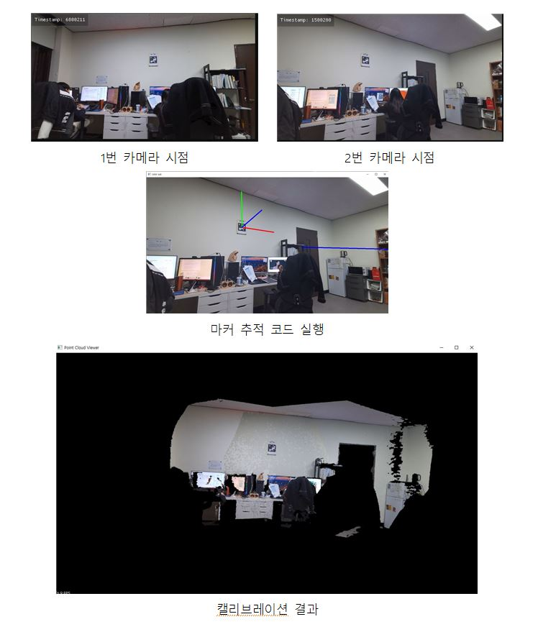
K4A GRABBER
PROJECT AZURE KINECT DK USING OPEN3D FOR VISUALIZE
코드 분석은 차후에 할 예정

Slide 10
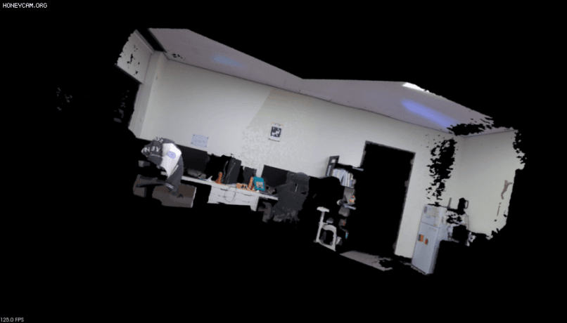
K4A GRABBER
PROJECT AZURE KINECT DK USING OPEN3D FOR VISUALIZE
Default Setting (ICP + ArUco)

Slide 11
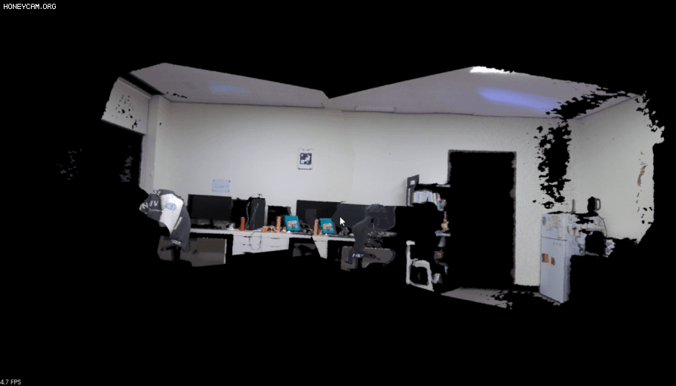
K4A GRABBER
PROJECT AZURE KINECT DK USING OPEN3D FOR VISUALIZE
Custom Setting (ArUco only)

Slide 12
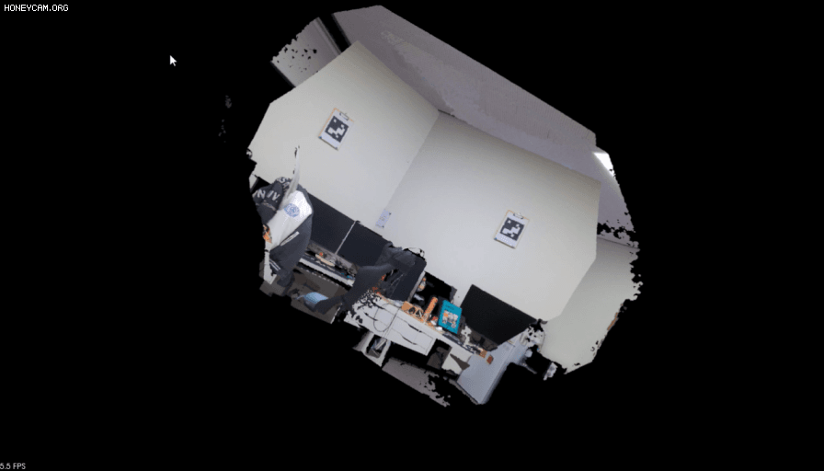
K4A GRABBER
PROJECT AZURE KINECT DK USING OPEN3D FOR VISUALIZE
Custom Setting (ICP only)

Slide 13
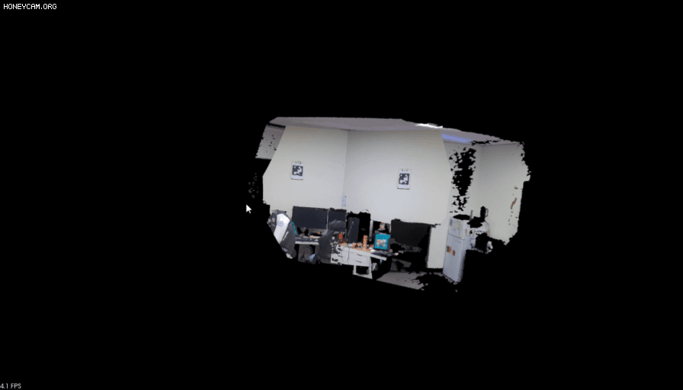
K4A GRABBER
PROJECT AZURE KINECT DK USING OPEN3D FOR VISUALIZE
Custom Setting (ICP only)

Slide 14
K4A GRABBER
PROJECT AZURE KINECT DK USING OPEN3D FOR VISUALIZE
Default (ICP + ArUco) | 기본적인 설정 Calibration 속도 보통 Calibration 수준 상
Only ArUco | Calibration 속도 비교적 빠름 Calibration 성능 중
Only ICP | Calibration 속도 느림 Calibration 성능 중, 하

Slide 15
THANK YOU

